Slide 1
Stochastic Cubic Regularization for Fast Nonconvex Optimization
Moscow, MIPT, 2020
Kyzyl-ool Kezhik,
Nursultan Kozhogulov
Ehson Kholzoda

Slide 2
Plan
How does this method differ from classical gradient descent?
How faster this method than other methods?
Our experiments and confirmations / refutations

Slide 3
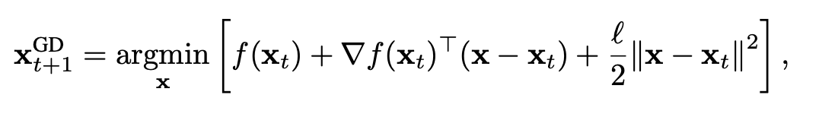
Gradient descent and Newton method
Classical gradient descent:
Cubic regularized Newton method:

Slide 4
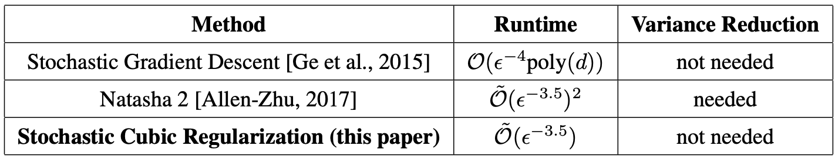
Comparing with other methods

Slide 5
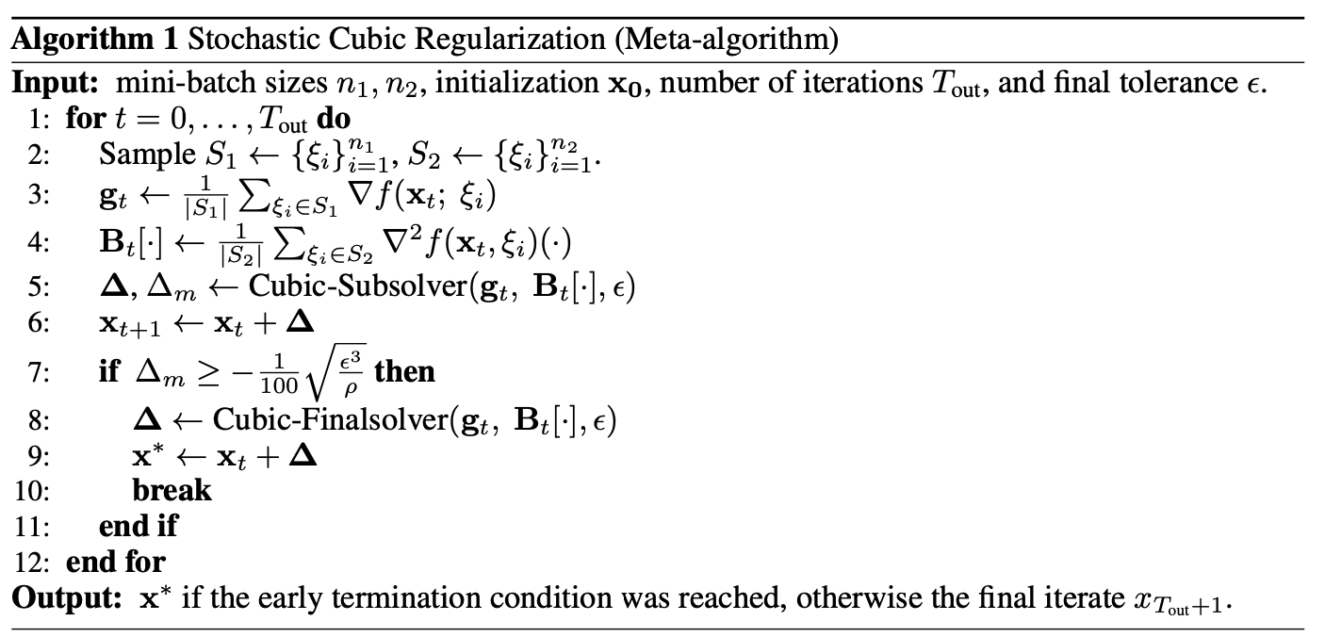
Meta-algorithm

Slide 6
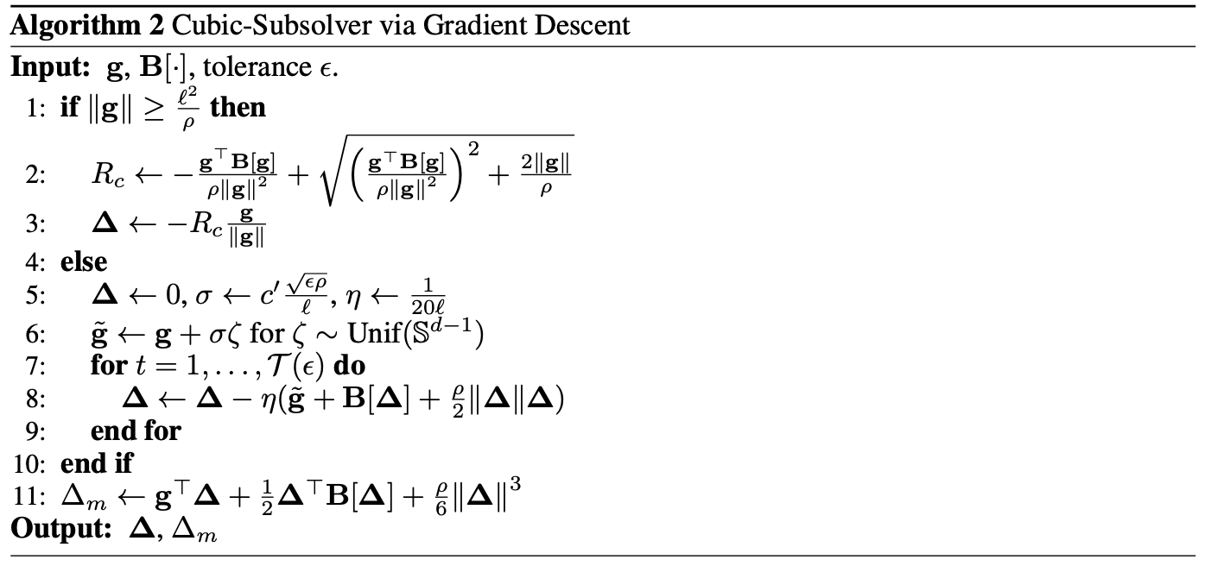
Cubic-Subsolver

Slide 7
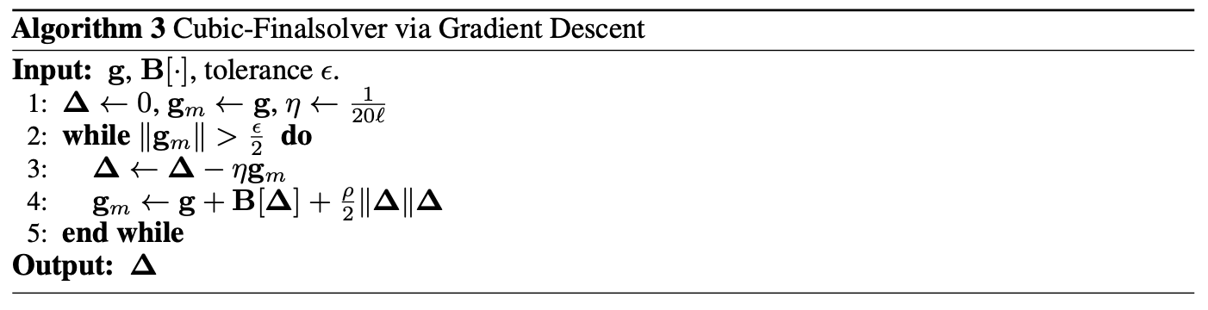
Cubic-Finalsolver

Slide 8
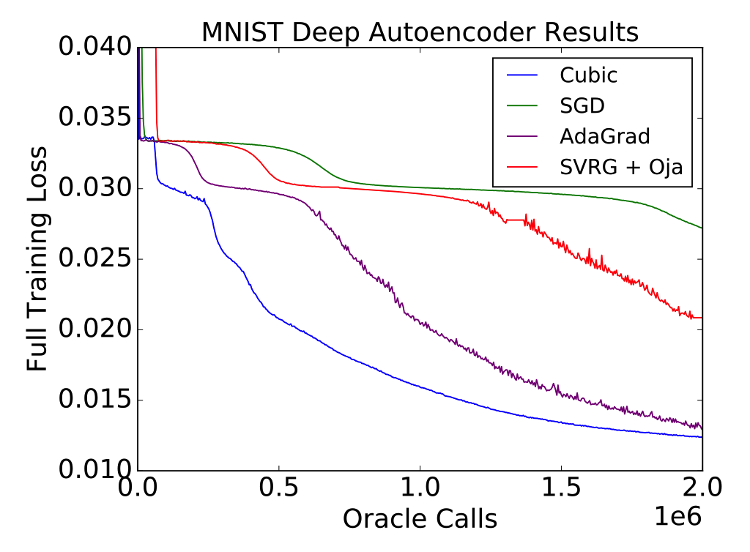
Method compared with other methods

Slide 9
Our experiments
To be continued….

